Slide 1



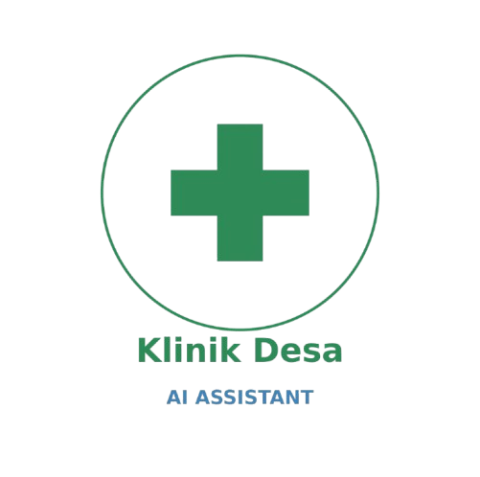


Klinik Desa AI Assistant
Presented by：
Kkbig

Slide 2
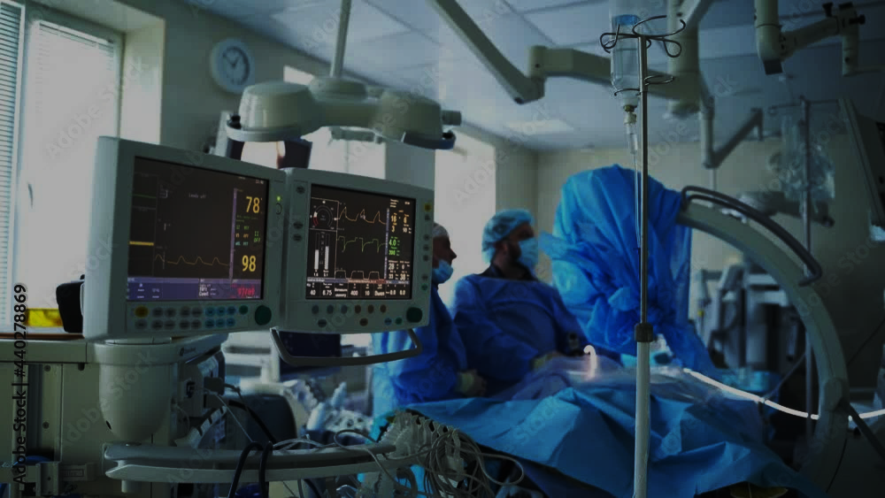
Problem Statement: The “Rural Healthcare Gap"

Slide 3



2
Specialists Scarcity
The Problems
1
3
Burden Overload
Complex SOPS

Slide 4

Our Target & Solution

Slide 5
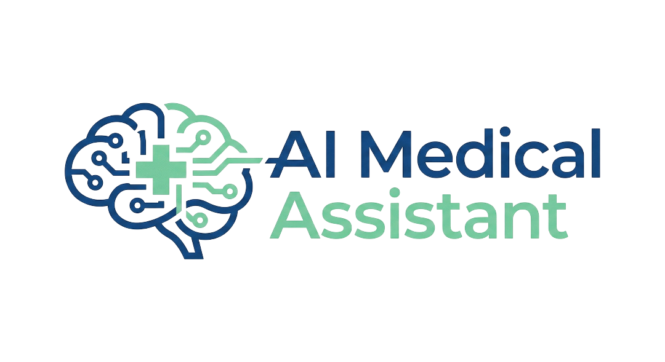
Target Users
Medical Officers in Rural and District Clinics
Junior Doctors in
Busy
Departments

Slide 6
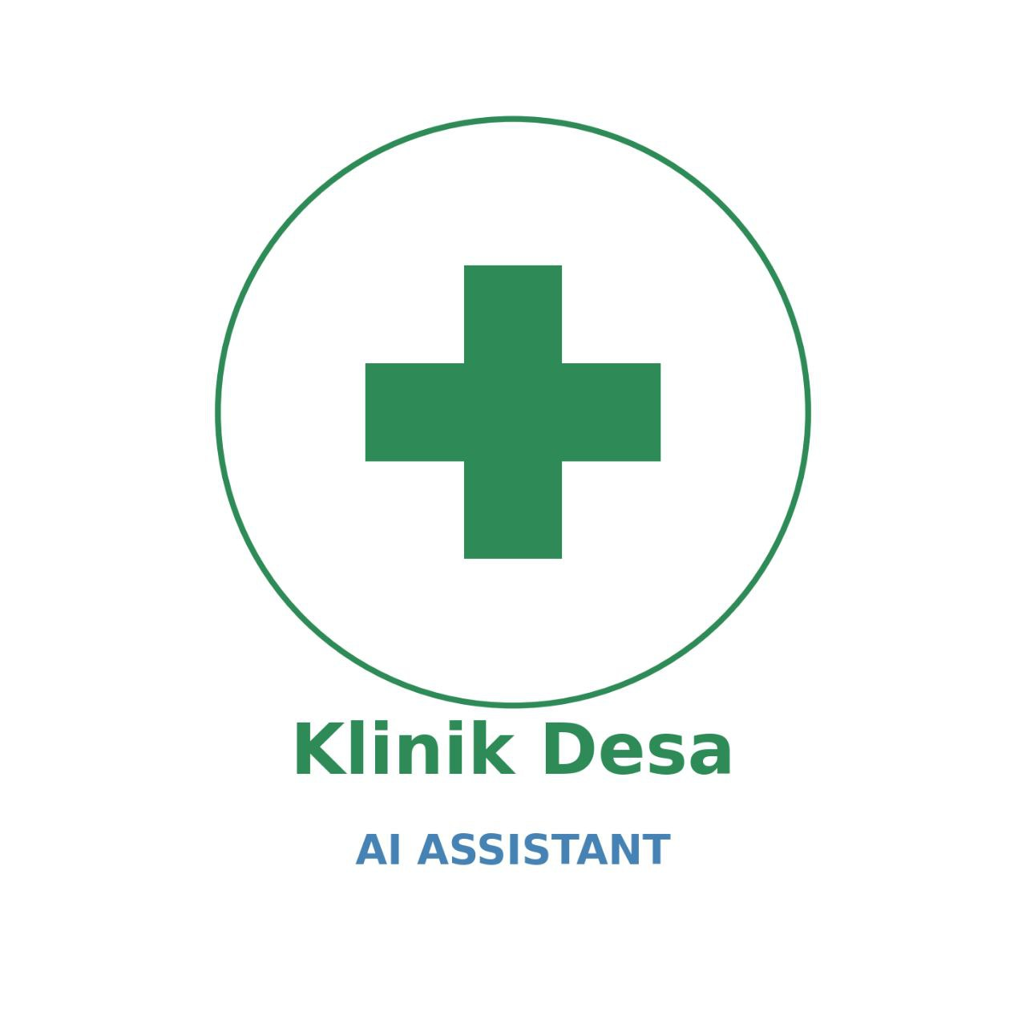
Our Solution
Vision
RAG
Action
Instantly screens CT scans for tumours
Automatically retrieves the correct MOH Referral SOP
Providing a “Digital Second Opinion” to reduce misdiagnosis and streamline patients to major hospital

Slide 7

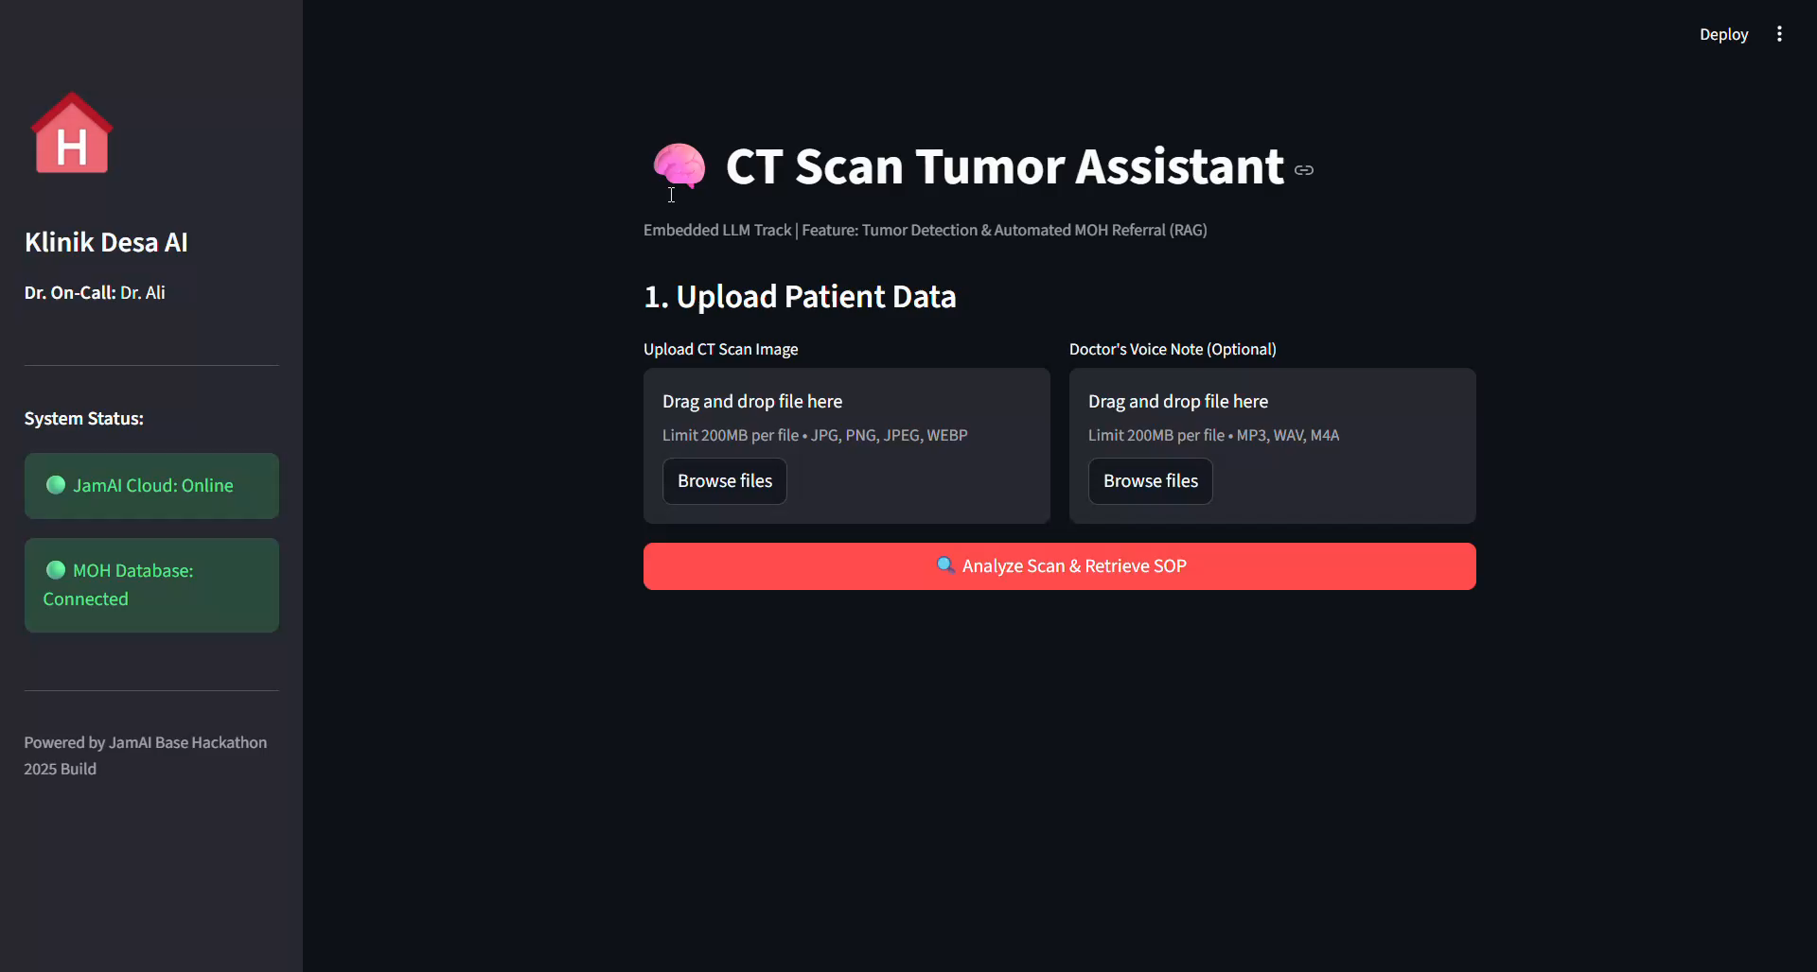
User Journey & Demo

Slide 8
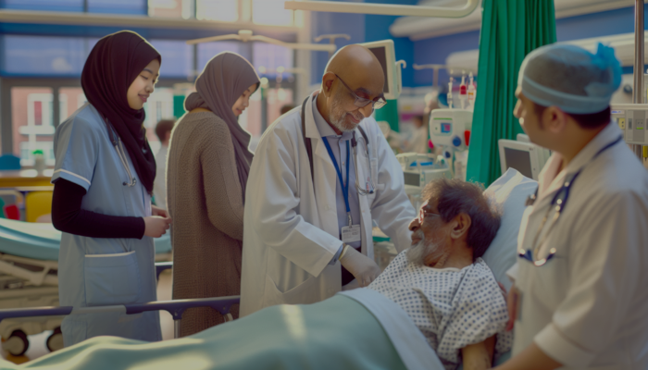
System Architecture and Data Flow
STEP
01
STEP
02
STEP
03
STEP
04
STEP
05

Slide 9
System Architecture and Data Flow
Multimodal Ingestion
Captures CT scan (image) and Doctor’s voice note (audio) via Streamlit frontend
STEP
02
STEP
03
STEP
04
STEP
05
STEP
01

Slide 10
System Architecture and Data Flow
Multimodal Ingestion
Context Injection layer
Captures CT scan (image) and Doctor’s voice note (audio) via Streamlit frontend
Transcribes audio into text and inject it directly into the Vision Model’s prompt
STEP
03
STEP
04
STEP
05
STEP
01
STEP
02

Slide 11
System Architecture and Data Flow
Multimodal Ingestion
Context Injection layer
Visual Reasoning
Captures CT scan (image) and Doctor’s voice note (audio) via Streamlit frontend
Transcribes audio into text and inject it directly into the Vision Model’s prompt
JamAI’s Action Table to analyze visual data and cross-referencing injected doctor’s context
STEP
04
STEP
05
STEP
01
STEP
02
STEP
03

Slide 12
System Architecture and Data Flow
Multimodal Ingestion
Context Injection layer
Visual Reasoning
Automated RAG Retrieval
Captures CT scan (image) and Doctor’s voice note (audio) via Streamlit frontend
Transcribes audio into text and inject it directly into the Vision Model’s prompt
JamAI’s Action Table to analyze visual data and cross-referencing injected doctor’s context
Queries clinic_knowledge table to retrieve specific MOH Referral SOPs upon diagnosis detection
STEP
05
STEP
01
STEP
02
STEP
03
STEP
04

Slide 13
System Architecture and Data Flow
Multimodal Ingestion
Context Injection layer
Visual Reasoning
Automated RAG Retrieval
SOP-Aligned Synthesis
Queries clinic_knowledge table to retrieve specific MOH Referral SOPs upon diagnosis detection
Combines visual findings, diagnosis and retrieved SOPs to generate actionable Referral Letter
Captures CT scan (image) and Doctor’s voice note (audio) via Streamlit frontend
Transcribes audio into text and inject it directly into the Vision Model’s prompt
JamAI’s Action Table to analyze visual data and cross-referencing injected doctor’s context
STEP
01
STEP
02
STEP
03
STEP
04
STEP
05

Slide 14
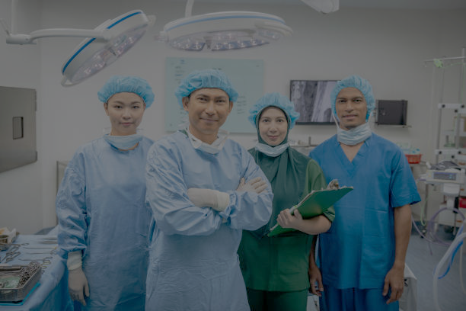
Our
Key Features

Slide 15
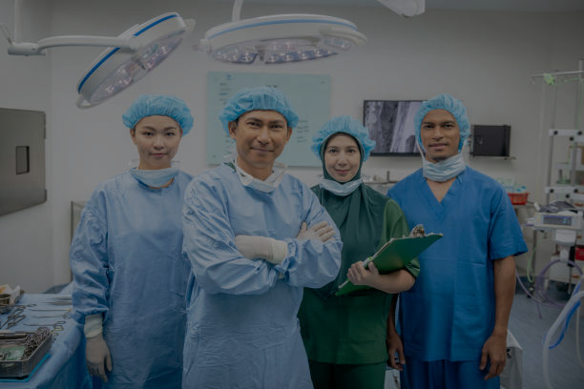
Our Key Features
Multimodal Tumour Detection (Vision+Audio)
Bilingual & Manglish Support
Generates both English and Malay Language to support diverse local medical staff
Handles Malaysian-accented English (Manglish) effectively
Visual Intelligence: Uses ELLM Qwen3 VL 30B
Context Injection: Uses Qwen-2 Audio
Localised RAG (MOH Guidelines)
Workflow Automation (End-to-End)
Implementing knowledge table containing MOH Malaysia Referral Guidelines 2025
Recommend the correct specialist centre
Zero Friction
Actionable Output: Instantly generates a downloadable .txt referral letter

Slide 16
Our Key Features
Multimodal Tumour Detection (Vision+Audio)
Bilingual & Manglish Support
Generates both English and Malay Language to support diverse local medical staff
Handles Malaysian-accented English (Manglish) effectively
Visual Intelligence: Uses ELLM Qwen3 VL 30B
Context Injection: Uses Qwen-2 Audio
Localised RAG (MOH Guidelines)
Workflow Automation (End-to-End)
Implementing knowledge table containing MOH Malaysia Referral Guidelines 2025
Recommend the correct specialist centre
Zero Friction
Actionable Output: Instantly generates a downloadable .txt referral letter

Slide 17
Our Key Features
Multimodal Tumour Detection (Vision+Audio)
Bilingual & Manglish Support
Generates both English and Malay Language to support diverse local medical staff
Handles Malaysian-accented English (Manglish) effectively
Visual Intelligence: Uses ELLM Qwen3 VL 30B
Context Injection: Uses Qwen-2 Audio
Localised RAG (MOH Guidelines)
Workflow Automation (End-to-End)
Implementing knowledge table containing MOH Malaysia Referral Guidelines 2025
Recommend the correct specialist centre
Zero Friction
Actionable Output: Instantly generates a downloadable .txt referral letter

Slide 18
Our Key Features
Multimodal Tumour Detection (Vision+Audio)
Bilingual & Manglish Support
Generates both English and Malay Language to support diverse local medical staff
Handles Malaysian-accented English (Manglish) effectively
Visual Intelligence: Uses ELLM Qwen3 VL 30B
Context Injection: Uses Qwen-2 Audio
Localised RAG (MOH Guidelines)
Workflow Automation (End-to-End)
Implementing knowledge table containing MOH Malaysia Referral Guidelines 2025
Recommend the correct specialist centre
Zero Friction
Actionable Output: Instantly generates a downloadable .txt referral letter

Slide 19
Tech Stack

Slide 20



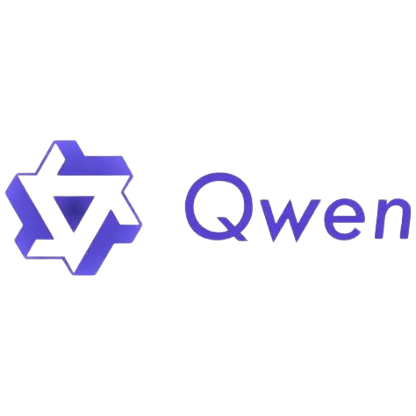
Tech Stack
Frontend Framework
Backend/AI Ops
Streamlit (Python)
LLM Orchestration (JamAI Base)
JamAI components
Models deployed
Action Tables and Knowledge Tables
Qwen3-VL-30B and Qwen-2-Audio-7B
Data Source
Official Malaysia MOH Referral Guidelines

Slide 21
Why Klinik Desa AI Assistant?
1
Not Just a Chatbot: We are a Workflow Automation Tool
2
Zero CapEx Implementation: Adopt AI without Constraints
3
Democratizing Specialized Care: Advanced AI Diagnosis
4
Safety & Compliance: Malaysia MOH Guidelines

Slide 22
QnA Session

Slide 23
THANK YOU
Klinik Desa AI Assistant
KKBig

